Slide 1
CS168: Discussion 4 - Routers II
Intro to the Internet
Spring 2025

Slide 2
Logistics
HW1: Architecture
Deadline: Monday February 24
Project 2: Distance-Vector Routing
Deadline: Tuesday February 28
HW2: Routing
Deadline: Monday March 17
Midterm on March 11, 7–9pm
Notes:
Ask, e.g. “how is project 1b going?”; “thoughts?” Jaewon note to self: this set of slides relatively short, so we have more time compared to last time; also will try to remember names lol when ppl raising their hands

Slide 3
Today’s topics
link-state routing
addressing
Notes:
say that this is covered in lecture 8 from last Tuesday

Slide 4
Link State Routing

Slide 5

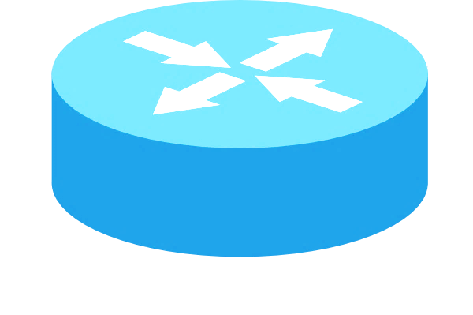
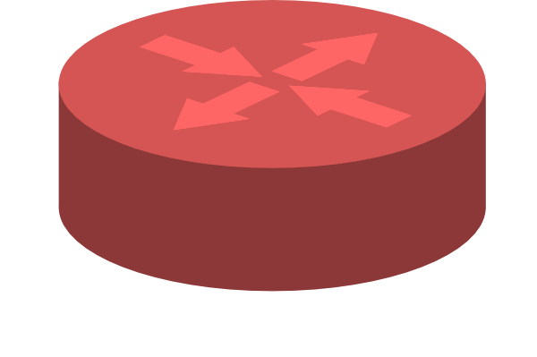
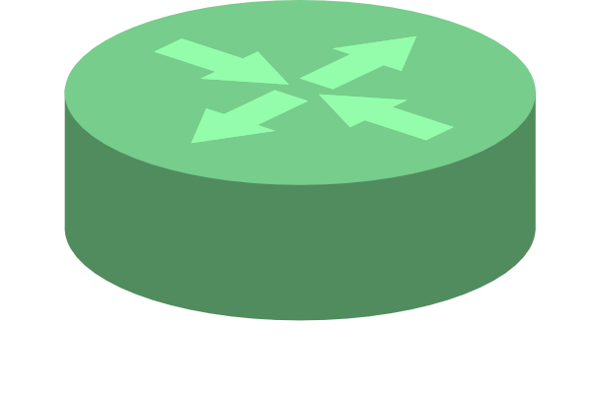
Link State Routing
Each router knows its own local “link state”:
State of each link to its neighbor (up/down)
Associated costs
1
4
2

Slide 6
Link State Routing
Router floods its link state to all other routers.
Each router learns global network topology
Then, computes shortest path themselves!
With Dijkstra’s, etc
1
4
2
Notes:
flooding = quickly send updates to all other nodes in the network

Slide 7
Link State Routing
Router floods its link state to all other routers.
Each router learns global network topology
Then, computes shortest path themselves!
With Dijkstra’s, etc
1
4
2
Notes:
Every router in the topology:
○ Gets the state of all links and the location of all destinations.
■ Need some way to distribute this graph!
○ Uses that information to build a full graph.
■ Glue together all link/destination information received.
○ Finds paths from itself to every destination on the graph.
■ Run some algorithm over the graph.
○ Uses the next-hop (adjacent router) in those paths to populate the forwarding table.

Slide 8
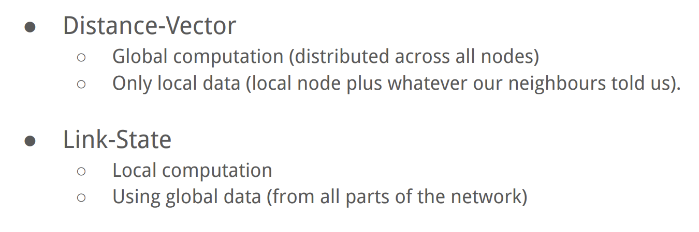
Distance Vector vs Link State
Notes:
compare/contrast: DV: global computation (distributed across all nodes) using local data LS: local computation using global data/view (state of every link in network; own view of world, not just neighbors)
What is “global data”?
○ The state of every link in the network.
○ Is it up or down?
○ What is its cost?

Slide 9
IP Addressing

Slide 10
Requirements of Addressing
Scalable Routing
Minimize state exchange needed to create paths
Efficient Forwarding
Small forwarding tables
Fast lookups
Host must be able to recognize packet is for them
An end-to-end check on routing
L3: IP addresses (dynamically assigned)
Notes:
-how to recognize? (MAC address for L2, IP address for L3)

Slide 11
IP Address
32 bits (for IPv4), split into 4 bytes, written in decimal (each decimal between 0 and 255)
Network prefix: /<bits>
Size of network address, counting from the leftmost bit
Example: 1.2.2.0/23
1.2.2.0/23
0000 0001 0000 0010 0000 0010 0000 0000
first 23 bits for network address
last 9 bits for host address
Notes:
CHANGELOG (02/24/2025):
Changed 1.2.3.0/23 in the example to 1.2.2.0/23 (bit 24 under ideal prefix convention should be set to 0, not 1)
Of the form- network:host
-routers ignore host part of address, hosts recognize packets are for them with host part of address
-called “slash notation”

Slide 12
Network prefixes (netmasks)
Prefix dedicated to network address
How can we tell if a host is in a network?
Check if the prefix matches!
Mask: 123.96.0.0/12
01111011 . 01100000 . 00000000 . 00000000
Addr: 123.100.42.6
01111011 . 01100100 . 00101010 . 00000110

Slide 13



Classful Addressing
Network classes:
A (/8): first 8 bits devoted to network
First bit is fixed to 0.
first byte from 0 to 127
Can have ~16M hosts, only 2^7 = 128 nets.
B (/16): first 16 bits devoted to network (first byte from 128 to 191)
First two bits are fixed to 10
Can have ~65K hosts, ~16K nets
C (/24): first 24 bits devoted to network (first byte from 192 to 223)
First three bits are fixed to 110
Can have only 254 hosts (255 is reserved for last byte) ~2M nets
Network bits
Host bits
Host bits
Network bits
Network bits
Host bits
Why is this a bad idea?
Very limited choices lead to waste of addresses
Notes:
-deprecated since the publication of RFC 1519 in 1993
-Class A far too big for most organizations
-Class C far too small for many organizations
-Class B is best option for many (still too big for many organizations and not that many of them)

Slide 14
Classless Inter-Domain Routing (CIDR)
Use two 32-bit numbers to represent a network
Network address = IP Address bitwise AND Subnet Mask
IP Address is 192.138.12.2
Subnet Mask is 255.248.0.0
Flexible division of bits:
More choices for the size of the network and hosts
Offers better size routing table and efficient IP address space
network address 192.136.0.0/13
1100 0000 . 1000 1010 . 0000 1100 . 0000 0010
1111 1111 . 1111 1000 . 0000 0000 . 0000 0000
IP Address
Subnet Mask
Notes:
-make the number of fixed bits arbitrary
-allows more granular assignment
-how much wasted address space could there be? (50%)

Slide 15
Prefixes
Easy to Add New Hosts
New host (5.6.7.213)
Forwarding table doesn’t need to be updated!
Easy to Add New Hosts
New host (5.6.7.213)
Forwarding table doesn’t need to be updated!
1.2.3.4
1.2.3.7
1.2.3.156
5.6.7.8
5.6.7.9
5.6.7.212
host
host
...
host
host
host
...
host
LAN 1
LAN 2
router
router
router
host
WAN
WAN
5.6.7.213
1.2.3.0/24
5.6.7.0/24
forwarding table
Notes:
-This is more or less aggregation: multiple network addresses (5.6.7.*) being routed to the same output port, so aggregate them into a common entry (5.6.7.0/24)
-a shared prefix (makes table less cluttered)

Slide 16

Questions?
Feedback Form: https://tinyurl.com/cs168-sp25-dis

